Slide 1


Data-Driven Storytelling Presentation:
Data Analysis
Account Sales Data

Slide 2
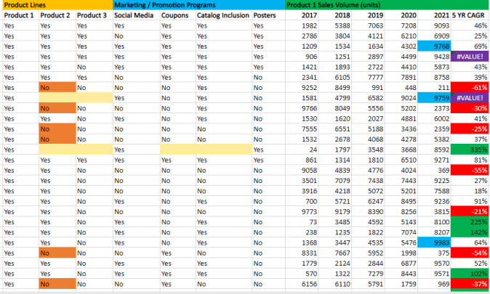
Data Cleaning and Modeling
Clean the unnecessary and invalid data for good understanding of the data and better visual.
Use conditions formatting to check show the error , low performance and best performance , empty values.

Slide 3
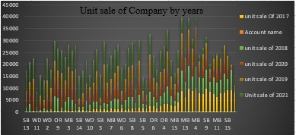
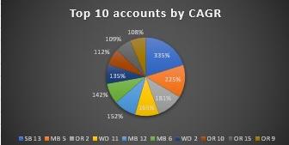
Data Visualization
To check the Sales of every year and growth draw the bar chart for more information and insight of the data.
Draw the pie chart for check top 10 account in Sales.
1-2 slides telling your story….

Slide 4
Key points and insight
Sales Performance Overview
By Analyzing the data past year sale indicates promising growth.
Year-over-year comparison shows a X% increase in total sales.
Insight: The growth trend suggests that our strategies are yielding positive results.
Account Type Analysis
Let's examine the performance of different account types.
Corporate accounts outperform individual accounts in units sold by X%.
Insight: Focusing on corporate accounts may lead to increased sale
Identifying Improvement Opportunities
While our overall sales have grown, some accounts are underperforming.
Account X and Account Y have seen declining sales over the past quarter.
Insight: We need to investigate and strategize for improving the performance of these accounts.

Slide 5
Summary
Our data-driven analysis underscores the growth opportunities within our account sales. By targeting the right accounts and implementing tailored strategies, we can continue on our path to success.

